Slide 1
UML and software analysis

Slide 2
Objectives
Introduction to UML
In the end, you should
Be able to identify diagram types
Interpret a diagram
Design correct diagrams
You will not learn how to design
Nor Model Driven Engineering

Slide 3

Why model ?
Convey abstraction
Communicate without unnecessary details
Help to deal with complexity

Slide 4

Who model ?
Virtually no one

Slide 5
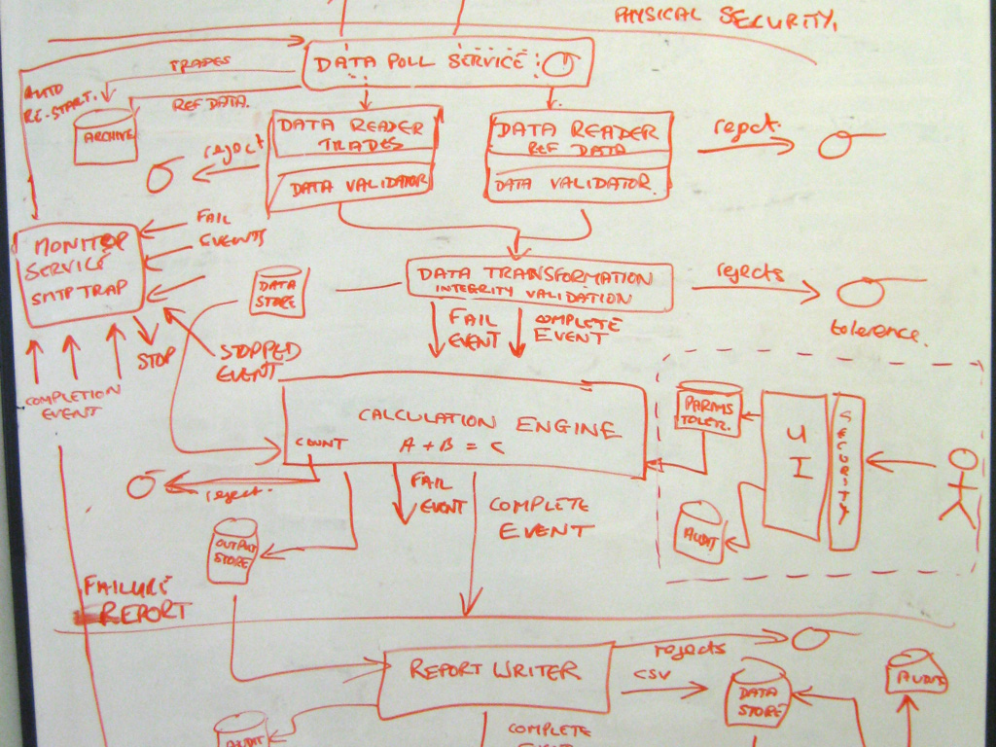
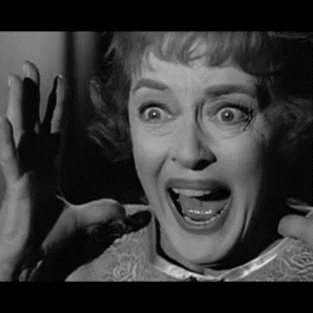
A Software architecture Model
https://c4model.com/

Slide 6
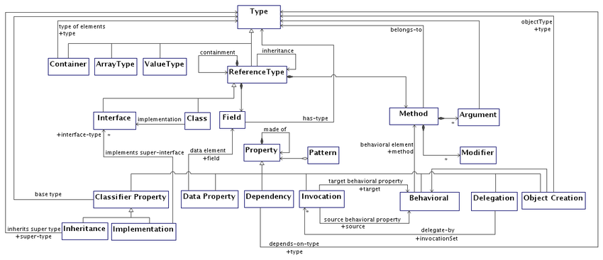
We need models, we like models, we love metamodels

Slide 7

Before UML
In the 90’s, apparition of several modeling paradigms
OMT (James Rumbaugh) – oriented towards analysis
Booch (Grady Booch) – more design oriented
OOSE (Ivar Jacobson) –
https://www.visual-paradigm.com/guide/uml-unified-modeling-language/what-is-uml/

Slide 8
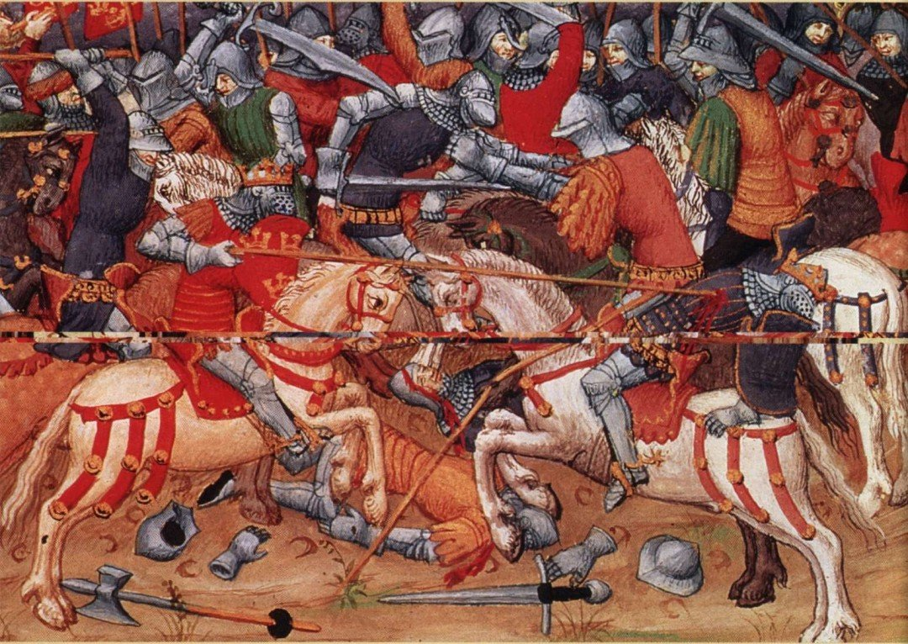

War of models
90 : La guerre des modèles
OMT
Rumbaugh
Grady Booch
UML
1995

Slide 9
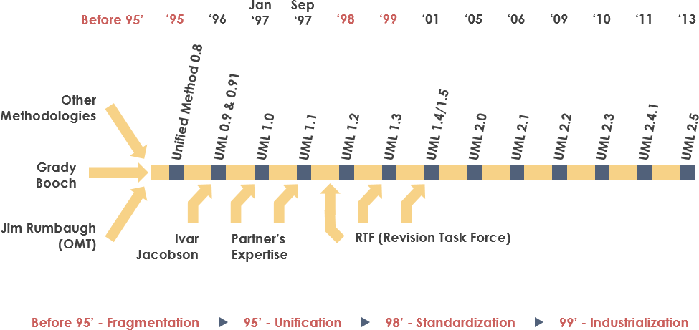
Unified Modeling Language
Need to standardize modeling languages
1994 = End of the models war
Unification of Rumbaugh and Booch propositions
Jacobson join the band (The three amigos)
Quick success
OMG (Object Management Group) take charge of the standard
www.omg.org
Version 2.5 in 2013

Slide 10

Definition
UML is a textual and graphical modeling language to
Understand and design requirements,
communicate
specify,
document,
architect,
design.
Used mostly for software intensive systems
bank, telecommunications, industry, avionics, healthcare, …
Notes:
Définition d’un vocabulaire et de règles de construction.
Modélisation graphique = atout majeur
Construction de modèles précis, non ambigus
Traduction des modèles en langage de programmation objet.

Slide 11
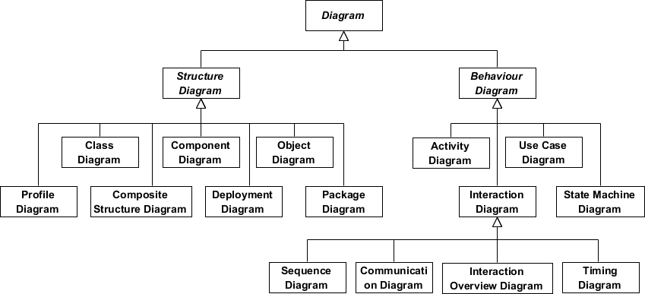
13 diagrams
Notes:
Définition d’un vocabulaire et de règles de construction.
Modélisation graphique = atout majeur
Construction de modèles précis, non ambigus
Traduction des modèles en langage de programmation objet.

Slide 12

Class Diagram
Structure diagram
Modeling of classes and entities
Attributes
Operations
Relations
Inheritance
Types

Slide 13
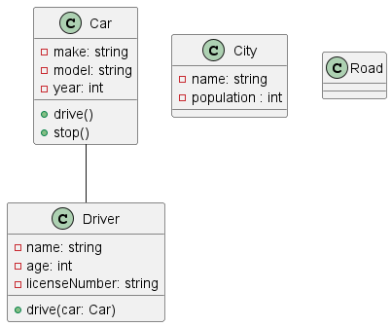
Class notations

Slide 14
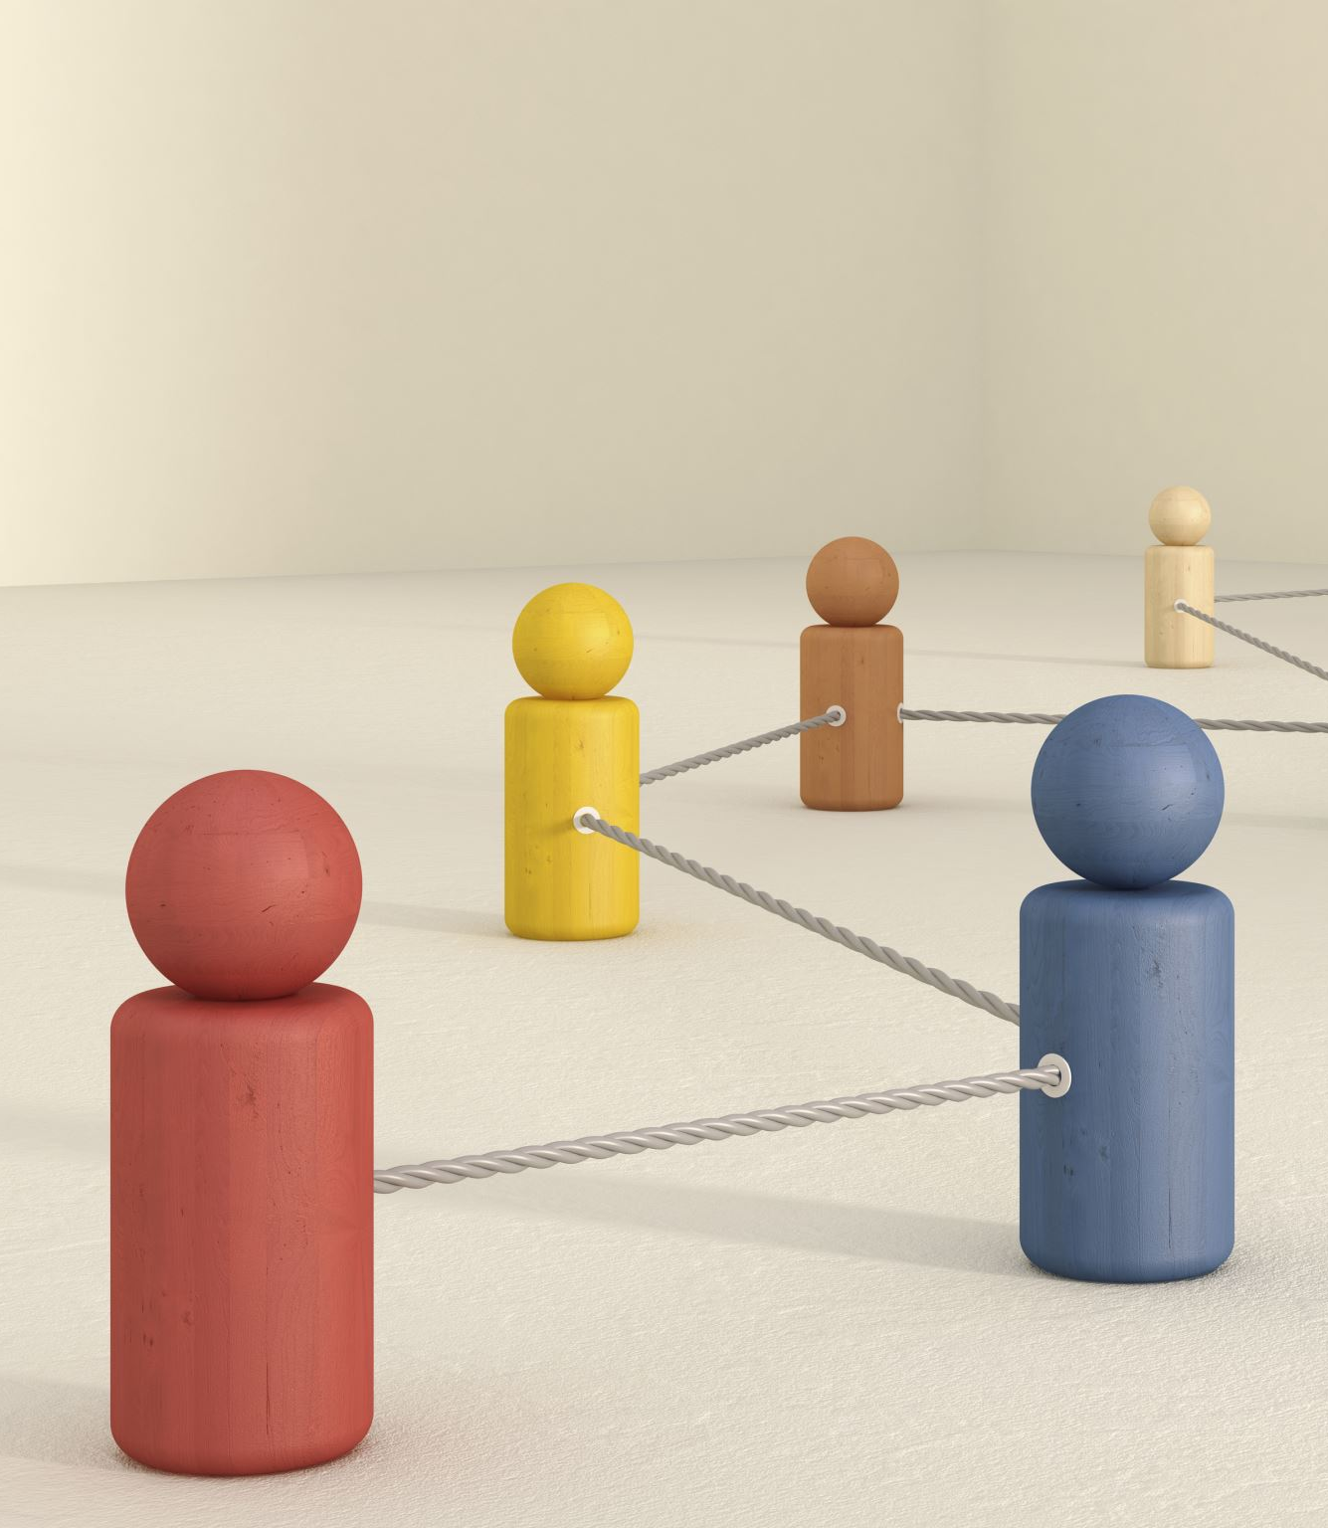
Relations
In UML, relationships describe how different elements of a system are connected to each other. There are several types of relationships, each with a specific meaning and notation.

Slide 15
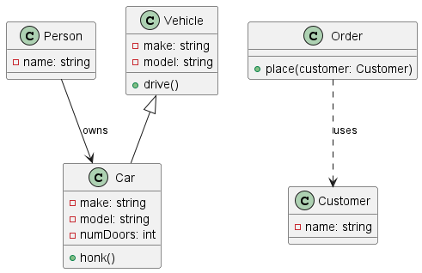
Different type of relationships
Association Relationship
Generalization Relationship
Dependency Relationship

Slide 16
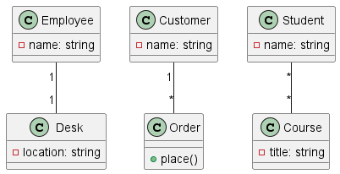
Cardinalities

Slide 17
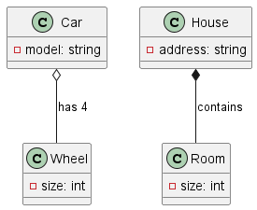
Aggregation vs Composition

Slide 18
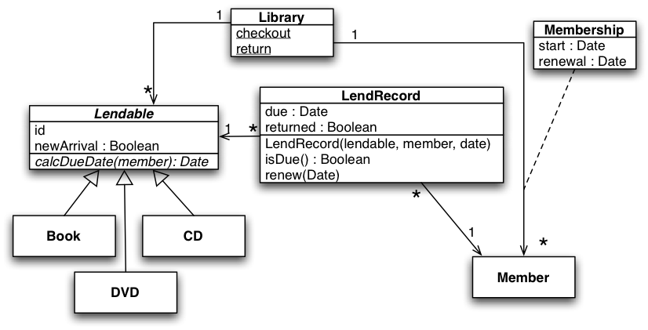
Example: Library Classes

Slide 19
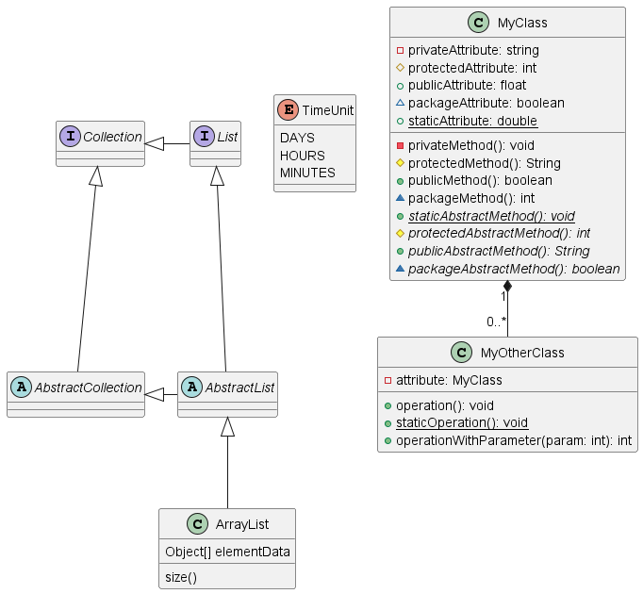
Notations

Slide 20
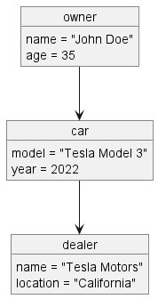
Object Diagram
An object diagram is a type of structural diagram in UML that shows a snapshot of the instances of classes in a system at a particular moment in time.
It represents the state of objects in the system, along with their relationships and attributes.
An object diagram can be seen as an instance-level view of a class diagram.
It is helpful in understanding complex systems, as it provides a visual representation of the current state of the system

Slide 21
Sequence Diagram
This diagram emphasises chronology.
Modeling the dynamic aspects of real-time systems and scenarios involving a small number of objects.
A rectangle and a lifeline represent an object.
Messages are represented by arrows going from the sender to the receiver.
They are used in two ways, depending on the development phase.
Documentation of use cases
Precise representation of interactions between objects and control flow distribution.

Slide 22
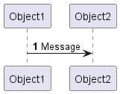
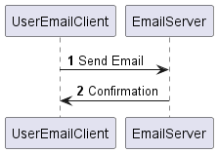
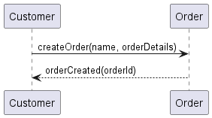
Sending a message

Slide 23
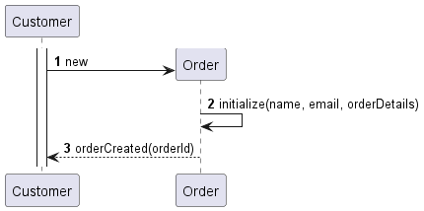
Sending a message to create an object

Slide 24
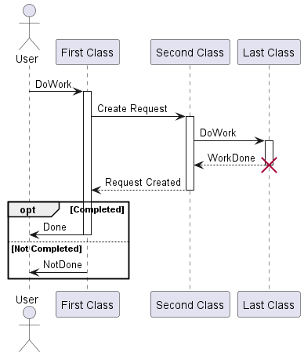
Example with an option bloc

Slide 25
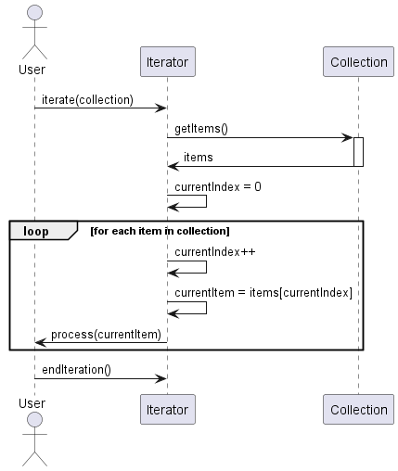
Example with an Iteration

Slide 26
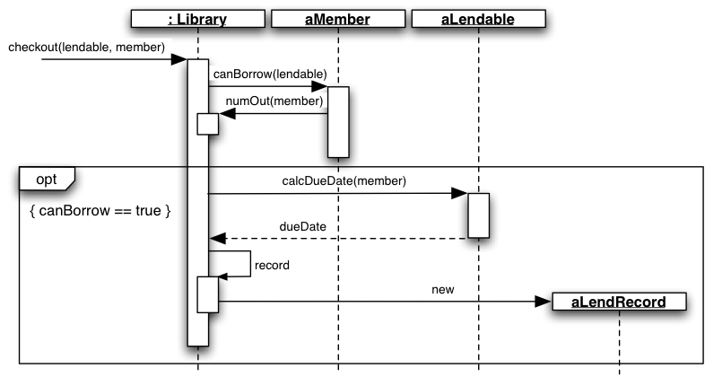
The Library

Slide 27
Communication Diagram
Used to model the interactions between objects or components in a system.
They are also known as "collaboration diagrams" or "interaction diagrams".
Show the relationships between objects or components in a system, as well as the messages that are exchanged between them.
The objects or components are represented as rectangles,
The messages exchanged between objects or components are represented as arrows, with the name of the message and any arguments or parameters included on the arrow.
Powerful tool for visualising the interactions between objects or components in a system, and can help developers identify and resolve system behaviour and performance issues.

Slide 28
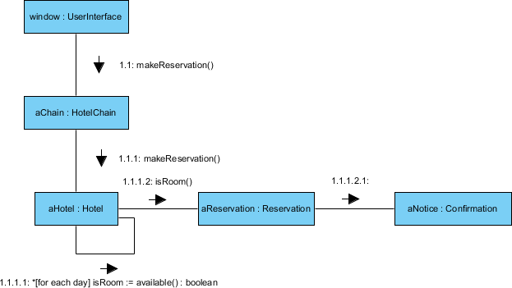

Slide 29
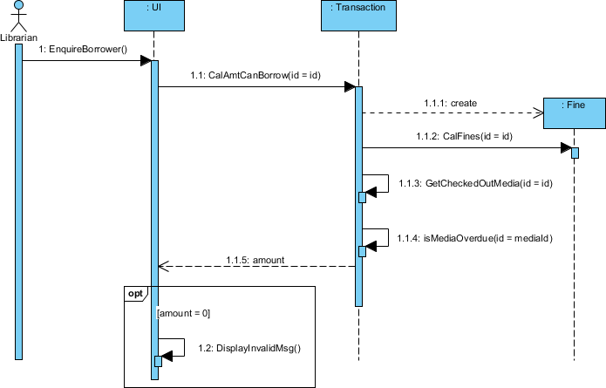
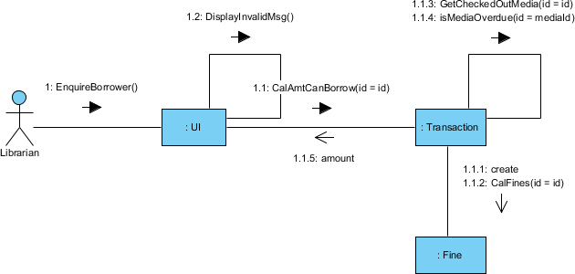
Sequence vs communication

Slide 30

Activity Diagram
A graphical representation of workflows
Models the dynamic behavior of a system
Captures the flow of control between activities
Can represent concurrent and parallel behavior
Visualizes the sequence of steps in a process

Slide 31
Key Elements
Activity: A unit of work or operation performed by the system
Control Flow: Arrows representing the flow of control between activities
Decision Node: A diamond shape representing a decision point
Merge Node: Merging multiple control flows into a single flow
Fork Node: Splitting a single control flow into multiple parallel flows
Join Node: Synchronizing multiple parallel flows into a single flow
Initial Node: The starting point of the activity diagram
Final Node: The end point of the activity diagram

Slide 32
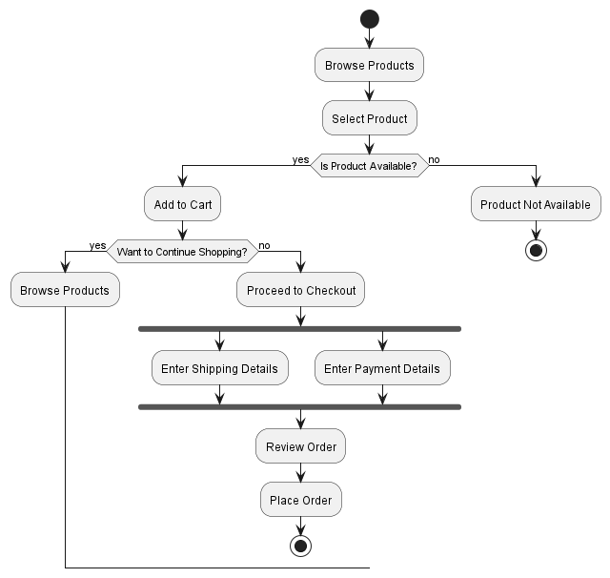
Online shopping activity diagram
https://www.visual-paradigm.com/guide/uml-unified-modeling-language/what-is-activity-diagram/

Slide 33
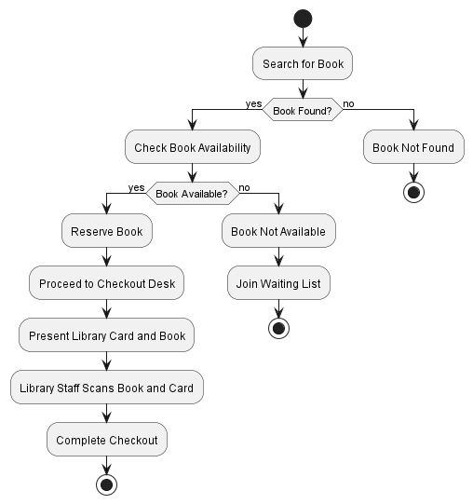
Library checkout activity diagram

Slide 34
State Diagrams
A graphical representation of the states and transitions of an object
Models the dynamic behavior of a single object over time
Captures the possible states and events that trigger state changes
Useful for understanding complex object life cycles

Slide 35
Key Eléments of State Diagrams
State: Represents a distinct condition or stage in the object's life cycle
Transition: Arrows indicating the movement from one state to another
Event: A trigger that causes a transition between states
Initial State: The starting state of the object
Final State: The ending state of the object

Slide 36
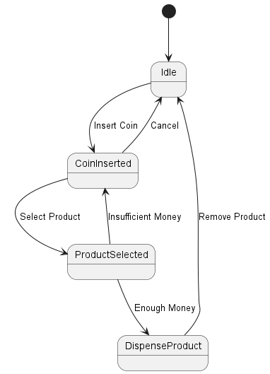
Example: Vending Machine State Diagram

Slide 37
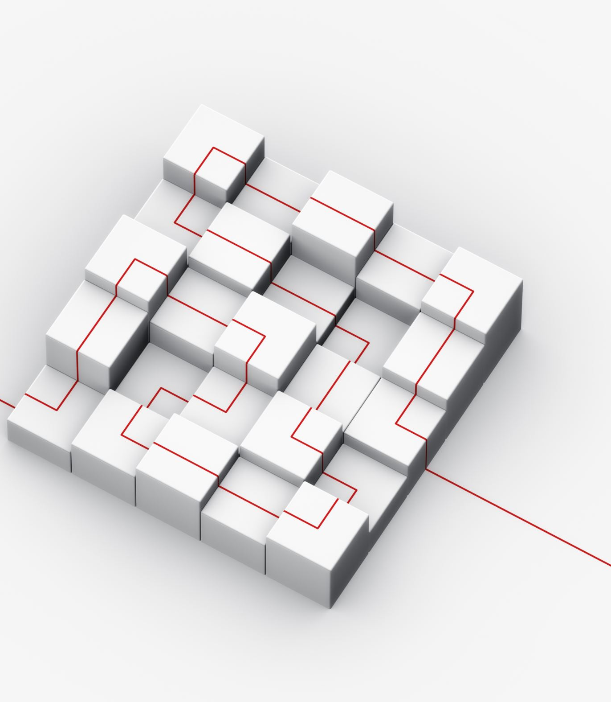
Component Diagram
Component diagrams are part of UML, which stands for Unified Modeling Language.
They're used to show the organization and dependencies of the components in a software system.
Components are modular parts of a system that encapsulate its functionality.
They can represent physical entities such as executables, files, and libraries, or logical entities such as software modules and subsystems.

Slide 38
Key Elements
A component diagram is composed of components, interfaces, ports, and dependencies.
Components are depicted as rectangles with their name and optional stereotype in the upper part and their implementation details in the lower part.
Interfaces are depicted as circles with their name and optional stereotype in the center.
Ports are depicted as small squares attached to a component or an interface, representing a point of interaction between the two.
Dependencies are depicted as arrows between components, indicating that one component uses or requires another component.

Slide 39
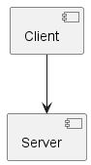
Simple example

Slide 40
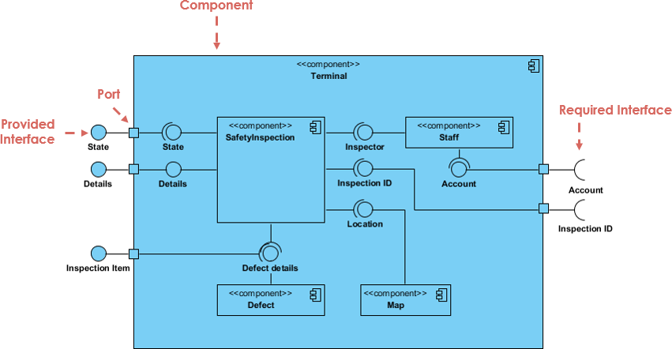
Notation

Slide 41
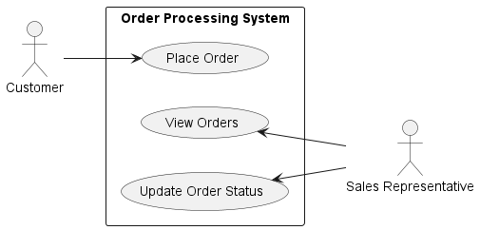
Use Case Diagrams
They're used to capture the functional requirements of a system from the user's perspective.
Use cases represent the interactions between the system and its users or other systems.
Actors are the users or other systems that interact with the system.

Slide 42
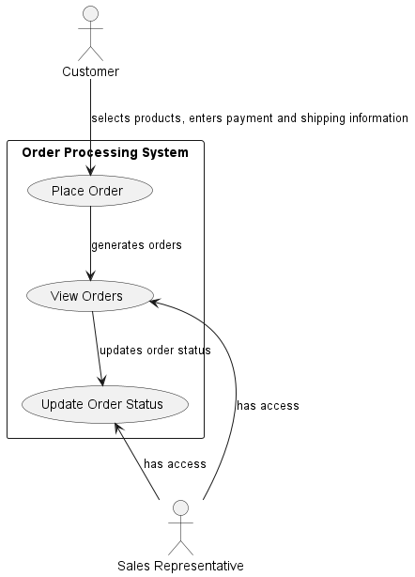
Example with relationships

Slide 43
Deployment Diagram
They're used to show how a system's software components and hardware resources are deployed or distributed.
Nodes represent the system's physical or virtual computing resources, such as servers, clients, and routers.
Artifacts represent the software components that are deployed on the nodes.

Slide 44
Key elements
A deployment diagram is composed of nodes, artifacts, and relationships.
Nodes are depicted as boxes with their name and optional stereotype in the upper part and their implementation details in the lower part.
Artifacts are depicted as rectangles with their name and optional stereotype in the center.
Relationships are depicted as arrows between nodes and artifacts, indicating the deployment or communication between them.

Slide 45
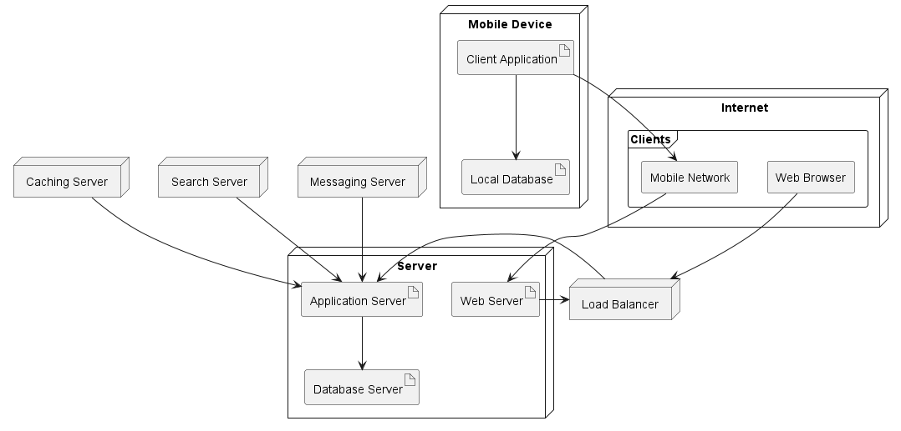
Example

Slide 46
UML and analysis
UML can be used at each stage of the software construction
UML for Analysis
Simplified Diagram
Avoid implementation decisions
Class Diagram as Entity Diagram
Represent domain objects and their attributes
Sequence Diagram
Represent exchange between the system and users or external systems
Activity Diagram
Represent high level Business Processes

Slide 47

UML for software design
This will be in another course

Slide 48
Sources
Cours de Martine Gautier
Cours de François Charoy
Cours de Pascal Molli
Slides de Lou Franco
http://www.extremeprogramming.org/
UML Distilled: A Brief Guide to the Standard Object Modeling Language, 3rd Edition
Martin Fowler
http://www.uml.org/
Le site de référence
De nombreuses figures sont issues de la spécification UML
D’autres figures ont été générées en plantUML par ChatGPT

